Slide 1
Nucleosynthesis
The Story of Atoms, Molecules, and Dark Matter
By Douglas Ettinger
Revision 0, 2014

Slide 2
Definition
The process that creates new atomic nuclei from pre-existing nucleons and leptons, primarily protons, neutrons, and electrons.
Three types of nucleosynthesis:
1. Big Bang – huge release of energy creating excessively high temperatures for a brief time.
2. Stellar – extreme pressures and temper- atures with longer times to create nuclei with higher atomic numbers.
3. Supernova – created by extreme pressures of an implosion at the core of the star adding energy.

Slide 3
Normal Matter and Dark Matter
Part 1 that follows deals with normal matter.
Made of atoms and plasma.
Detectable by electro-magnetic radiation.
Possesses gravity.
Produced during Big Bang.
Part 2 presentation deals with dark matter.
Particle characteristics supposedly unknown.
Only detectable by gravity.
Produced during Big Bang → new star bursts.
A source and reason for dark matter is proposed

Slide 4
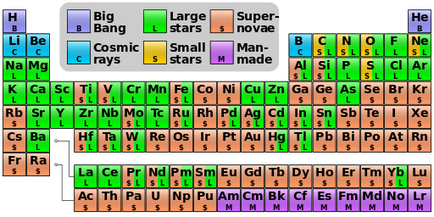
Periodic table showing the origin of elements
Based on data at http://www4.nau.edu/meteorite/Meteorite/Book-GlossaryN.html .

Slide 5
Earlier Ideas Become Foundation for Nucleosynthesis
Early 1800’s – John Dalton used concept of atoms to explain how elements always react.
1869 – Dmitri Mendelev credited for Periodic Table of Elements that predicted other elements.
1897 – J.J.Thomson discovered electrons.
1909 – E. Rutherford proposed atom’s nucleus.
1913 – Neil Bohr suggested electrons have quantized orbits.
1916 – Gilbert Lewis explains chemical bonds.

Slide 6
Recent History for Nucleosynthesis
1920 – Arthur Eddington suggested star’s energy comes from fusion of H & He.
1931 - Georges Lemaitre devises the Big Bang.
1946 – Fred Hoyle created idea that heavier elements are produced inside stars.
1950’s – Particle accelerators & detectors.
1950 – H.Suess & H.Urey → Abundance tables
1957 – A review paper by E.&G. Burbidge expanded fusion processes inside stars.

Slide 7
Both Hoyle and Lemaitre Models Needed to Explain Abundances; Hence, the Big Bang was adopted.
Existence of deuterium, isotope of hydrogen.
Existence of nuclides between He & Carbon.
Fundamentally high amount of He both in stars and interstellar gases.
¹₂H, Li, Be, B, and high amount of He cannot be produced inside stars.

Slide 8
Review of Atom and its Internal Forces
The nucleus:
Composed of protons and neutrons.
Their quarks are held together by the strong force.
Force carrier is the gluon acting over extremely short distances.
Proton and neutron held together by the weak force that can transmute these two nucleons.
5. Force carriers for weak force are bosons.

Slide 9
Review of Atom and its Internal Forces
The electron cloud:
1. Generally composed of equal number of
electrons as protons in the nucleus.
2. Atoms with unequal no. are charged ions.
3. Held to atom by electromagnetic forces.
4. Force carrier is the photon that can
interact over large distances.
5. Atoms are held together by same forces.

Slide 10
Atoms are the Basic Unit of Matter
Electromagnetic forces hold atoms together in various ways to form molecules.
The number of protons in the nucleus gives the atomic number.
The number of total nucleons in the nucleus gives the atomic weight.
The larger the conglomeration of atoms the
stronger becomes its resulting gravity force.

Slide 11
Other “Particle Physics” Terms
Quarks – 3 different types or flavors make-up either a neutron or a proton.
Leptons - Practically massless and immune to the strong force – include electrons, muons, pions, and neutrinos.
Fermions – quarks and leptons as well as most of their composites.
Bosons – photons and other particles of force and transmission.

Slide 12
Big Bang Nucleosynthesis
Maker of First Hydrogen and Helium Nucleons and Atoms
Tremendous temperatures within a crowded space created photons coupled with fermions.
Further expansion and cooling led to a cloud of nucleons and electrons.
More expansion led to fusion of nucleons into isotopes of H and He nuclei.
More space allowed decoupling of photons to escape matter and travel into the outer void.
More cooling led to coupling of nucleons and electrons to form atoms.

Slide 13
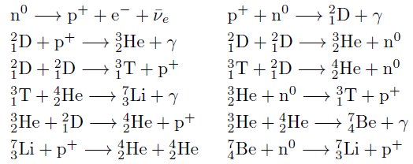
Chief Nuclear Reactions During the B.B.
*These reactions stopped after 20 minutes due to rapid cooling.
*Some ⁷LI and ⁷Be were made after 100 to 300 seconds.
*Most isotopes of H and He were produced during Big Bang.

Slide 14
First Nuclear Reactions
Production of first matter is neutrons (n⁰)
Neutrons split to create protons, p⁺, and electrons / neutrinos, e⁻ / ѵ_{e}
A proton + neutron combine to form a hydrogen isotope ²₁D (deuterium) & a photon.
²₁D (deuterium) + proton( p⁺ ), produces helium isotope, ³₂He, and a photon.
Other sequence of combinations eventually create small amounts of Li and Be and B.

Slide 15
Universe Keeps Expanding and Cooling
Lumpiness on a micro-scale with help of Li, Be, and B seeding and the circuits of electrified plasma and Z-pinches create the first stars.
Lumpiness on a macro scale creates the first galaxies composed of these massive short-lived stars called Population III.
Massive short-lived stars repeatedly explode and re-form until smaller, longer-lived stars called
Pop. II begin to populate the young galaxies.

Slide 16
Macro-lumps or Galaxies Keep Expanding
While massive stars are still close together they easily expel matter toward each other quickly for 3 to 5 more generations.
As more space is created between stars in a galaxy, continued explosions or supernovae create smaller stars that become more long-lived having produced and/or gathered increasing amounts of higher metals.

Slide 17
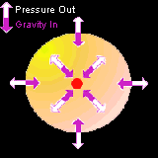
Stellar Nucleosynthesis Uses Gravity and Thermal Expansion of Nuclear Fusion

Slide 18
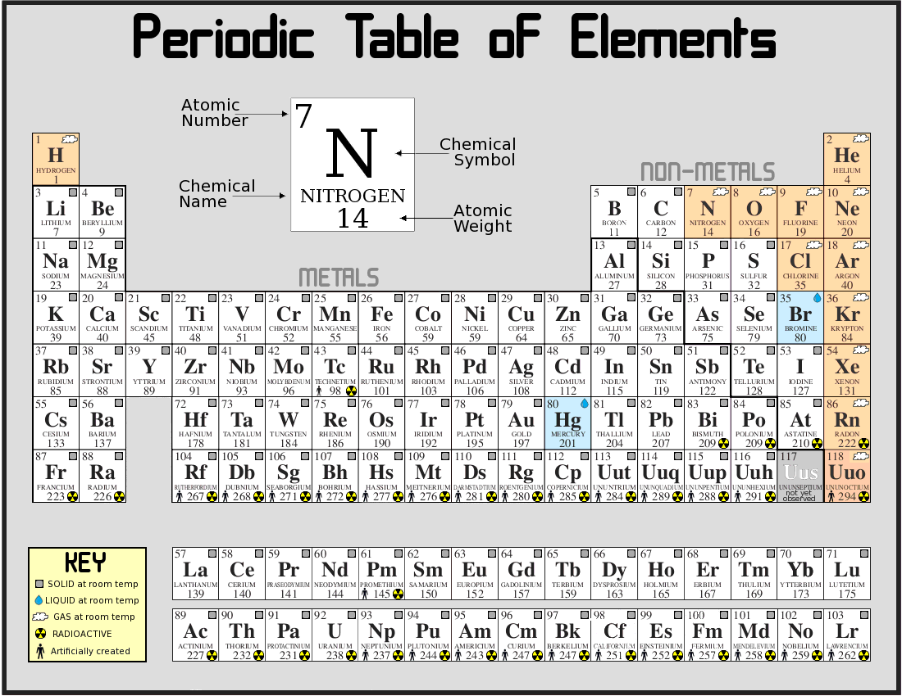
Stellar Nucleosynthesis -
Maker of Heavier Metals Between Helium and Iron

Slide 19

Abundances of Chemical Elements

Slide 20
General Trends for Elements
Hydrogen and helium are the most common elements from the Big Bang nucleosynthesis.
The next 3 elements; Li, Be, and B are rare being poorly synthesized in Big Bang and stars.
Alternation of abundance according to whether they have even or odd atomic no’s.
General decrease in abundance as elements become heavier, except in the region of iron and nickel.

Slide 21
Most Abundant of Heavier Metals
From the logarithmic graph the most abundant elements after H and He are:
Carbon-C, nitrogen-N, oxygen-O, neon-Ne, aluminum-Al, magnesium-Mg, silicon-Si, sulfur-S, iron-Fe, nickel-Ni, and calcium-Ca.
Major constituents of rock are basically the same elements: C, O, Al, Mg, Si, Ca, Ni, and Fe.
Major constituents of volatiles of solar system bodies are H, He, N, O, and C and make-up -
Major constituents of most abundant mole- cules: H₂0, CH₄, CO₂, NO_{n}, SiO_{n}, & NH₄.

Slide 22
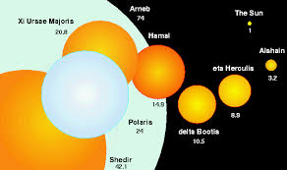
Scale of Largest Stars
Massive Population III stars keep exploding and eventually divide into many medium size,Population II stars with higher metallicity.

Slide 23
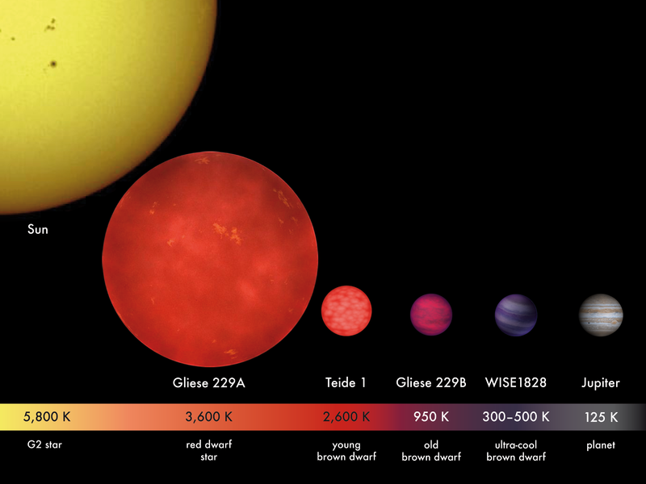
Continuing Explosions of Large Stars Create the Most Numerous Objects in the Universe: Dwarf Stars and Planets
Our Sun is a long-lived yellow dwarf star , Population I, with the highest metallicity,

Slide 24
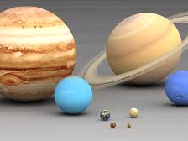
The Scale of Solar System Planets
All the major constituents of these planets came from the elements of stellar nucleosynthesis . These planets also have a similar concen- tration of these elements as do the postulated cores of fusing stars.

Slide 25
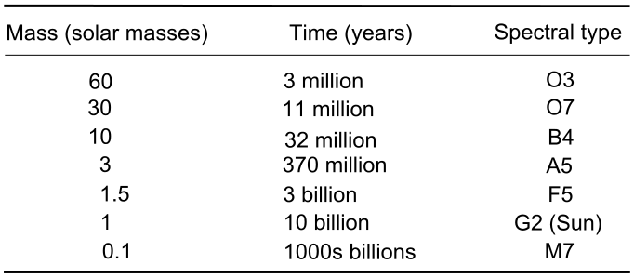
Evolution of Different Mass Stars

Slide 26
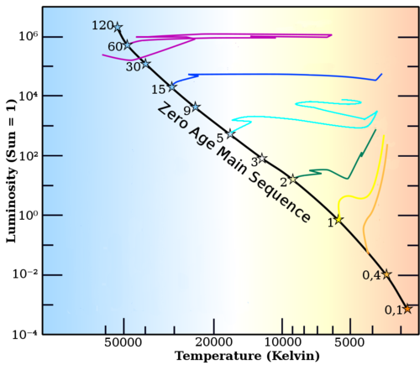
Lifetime of Different Mass Stars on the Main Sequence

Slide 27
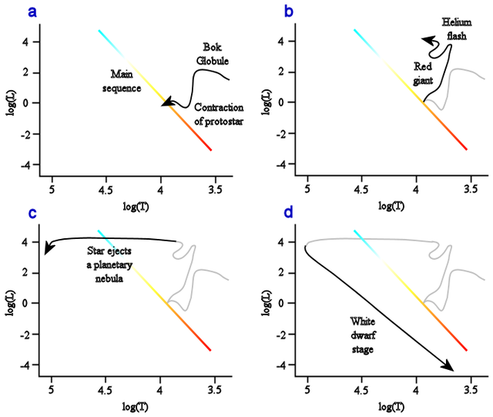
Movement of Star on Hertsprung-Russell (H-R) Chart During its Lifetime

Slide 28
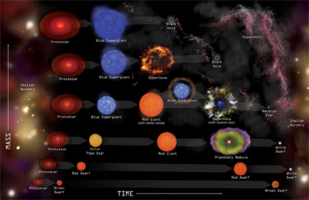
Differing Remnants & Progenitors

Slide 29
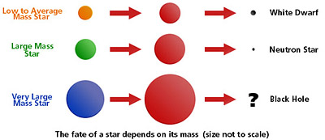
Fate of Various Star Masses

Slide 30
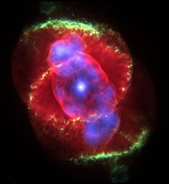
Typical Planetary Nebula
NGC 6543

Slide 31
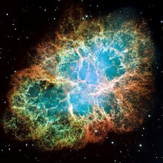
Typical Supernova Remnant
Crab Nebula

Slide 32
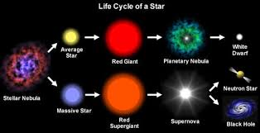
Some Items to View Thru a Telescope

Slide 33
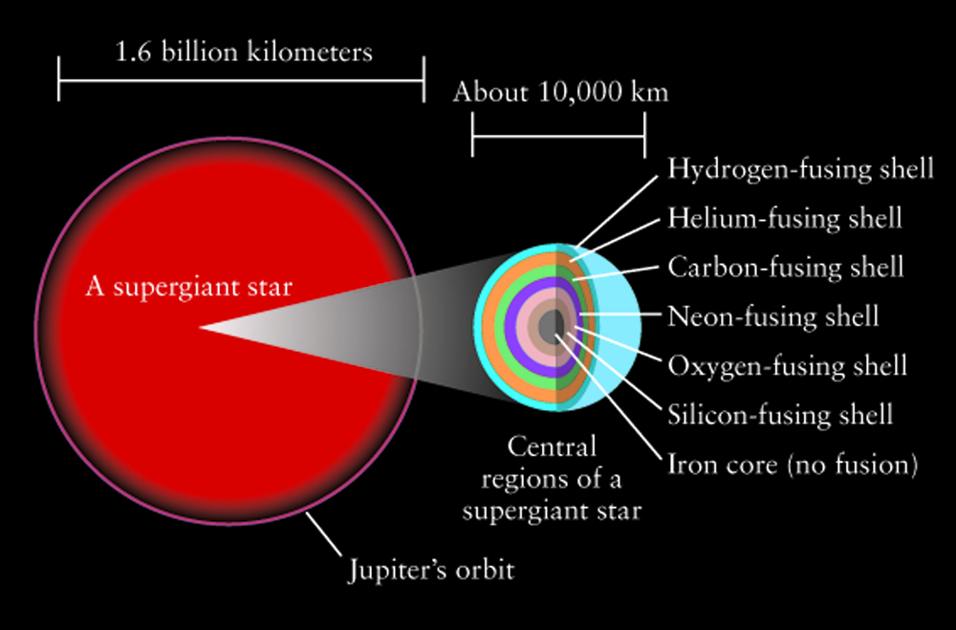
Cores of Massive Stars Favor Certain Elements in the Fusion Process

Slide 34
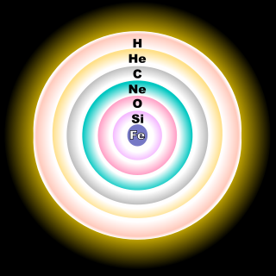
These Favored Elements Compose Most of the Matter that is not Gas or Plasma;
They Were the Fusion Shells of Evolving Stars

Slide 35
First Fusion of Hydrogen to He
This process involves 3 different types of chain reactions:
Deuterium burning: ¹₂H + p → ²₃He
Proton – proton or pp chain producing ²₂He
Carbon-nitrogen-oxygen (CNO) cycle; delays more older, massive stars from burning too fast.

Slide 36
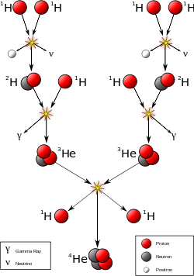
Proton-proton Chain Reaction Sequence

Slide 37
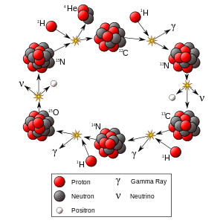
Carbon-nitrogen-oxygen (CNO) Cycle

Slide 38
Helium Fusion Produces Carbon
Triple alpha process produces carbon shown on next slide.
Alpha ladder process produces at very low rate O, Ne, Mg, Si, and S.

Slide 39
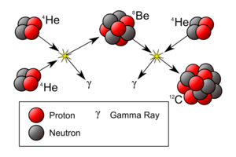
Helium fusion via Triple Alpha Process

Slide 40
Carbon Fusion Produces Mostly Neon and Oxygen
8 to 11 solar mass (M_{Θ}) star leaves behind carbon and oxygen and a O-Ne-Na-Mg white dwarf.
> 11 (M_{Θ}) star proceeds to a neon-burning process.

Slide 41
Neon Fusion Produces Primarily Oxygen and some Mg
Details for transition between fusion shells is given for Ne to O:
Ne burning begins after C burning consumes all carbon in its ignition layer.
A new O-Ne-Mg core is created.
The core ceases fusion burning and contracts.
*A rebound of energy releases parts of the upper shells of carbon, helium, and hydrogen into the interstellar medium (IM)

Slide 42
Each Fusion Transition Creates a Release of Materials in the Equatorial Regions from the Outer Shells
5. Increased temperatures allows neon to burn.
6. Other shells are still burning C, He, and H.
7. O and Mg accumulate in the central core.
8. After Ne is consumed within a certain core shell of required temp. and press. ranges, the core ceases fusion & contracts.
9. * Sudden release of energy expels more material from star’s surface generally around the equatorial regions.
9. Again gravitational pressure takes over until oxygen burning can start.

Slide 43
Final fusion processes occur quickly
Oxygen fusion: produces primarily Si
Silicon fusion: produces primarily Fe, Ni, & Zn. The Ni and Zn rapidly decay to Fe.
No additional energy can be generated for another reaction for Si fusion. A rapid contraction occurs causing a Supernova Type II

Slide 44
Supernova (SN) Nucleosynthesis
Supposely (?), the central portion gets crushed into a neutron star or blackhole.
The outer layers blow away in a Supernova – Type II, Ib, or Ic creating a SN remnant.
An immense burst of new neutrons creates the other rarer elements above iron, Fe.
The SN remnant materials seed the IM to produce future stars and planets.

Slide 45
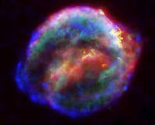
The Kepler Supernova Remnant
Composite image taken from Spitzer, Hubble and Chandra X-ray Telescopes

Slide 46
SN Nucleosynthesis Processes as Envisioned by Fred Hoyle
R-process: rapid capture of neutrons by seed nuclei.
RP-process: consecutive proton capture onto a seed nuclei.
Photodisintegration: high energy gamma rays enter atom nucleus and emit a nucleon or alpha particle.

Slide 47
Controversial, but Cautious Proposals Deviating from the Standard Model
Expulsion of materials from a supernova cannot be simulated by computer modeling.
1. Perhaps the expulsion is primarily from equatorial regions where centripetal spin forces aid in acting against gravity.
2. Perhaps a large percentage of the outer layers is expelled each time during a fusion shell transition. Some diagrams follow to show stellar evolution.

Slide 48
Can Seeds for Proto Stars & Planets Come from Supernova Remnants ?
The current nebular hypothesis becomes less and less convincing for forming stars.
Stellar nucleosynthesis produces the “primary elements” required for planets.
The nuclear “fusion shells” of a star disperse these elements in a systematic, sequential manner, but
The successive explosions are chaotic enough to produce clumpiness with varying sizes.

Slide 49
5. Final explosion expels spinning orbs of iron
providing very strong electrical and magnetic
properties with connecting circuits.
6. The properties can then gather the reheated
plasma of previously expelled materials.
7. This capturing process leads to differen-
tiated objects of varying types of cores & also
varying surrounding materials in amount/type.
8. Many of these objects and their surrounding
medium can have close proximity to create
proto-star disks and planetary systems.

Slide 50
The Feats of Nucleosynthesis
Unending, omnipotent, omnipresent
Produced by infinite stars and their supernovae
Produces all matter and life.
Amazingly highly organized producing new stars.
Defeats entropy with re-birth

Slide 51
Appendix of Static Heads for Evolving Stars and Planets
These static heads represent a column of matter from the core to the surface of typical celestial objects. The state of this matter is both computed & postulated.
Your own postulations are welcome.

Slide 52
Part II
The Story of Big Bang - Nucleosynthesis
And Dark Matter

