Slide 1
Sailing from tahiti
Searching for the land of Mu

Slide 2
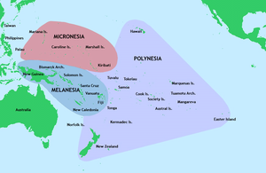
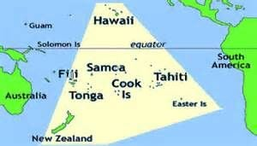
Polynesian Islands - Form a triangle between Hawaii, Easter island, and New Zealand

Slide 3
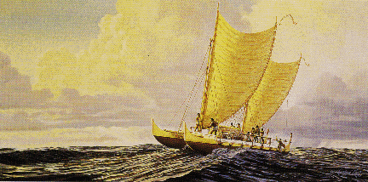
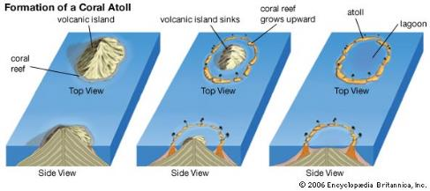
Polynisians were proficient sailors
These seafaring people had colonized all the larger islands before the Europeans arrived
The islands range from exposed volcanoes to coral atolls

Slide 4
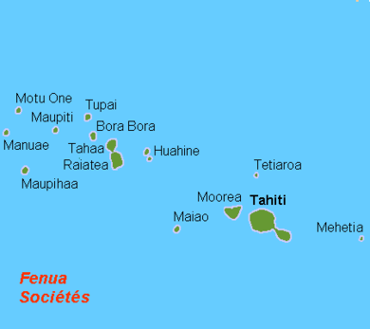
The society islands – Papeete , Tahiti is the Capital
Like these islands most in the south pacific occur in small groupings caused by geological hot spots.

Slide 5
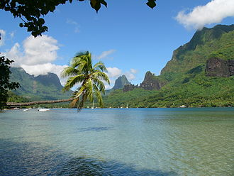
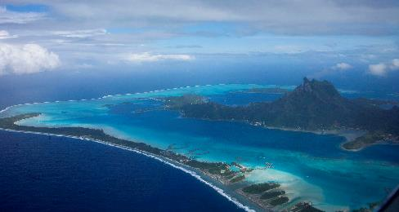
French Polynesia: Moorea and bora bora

Slide 6
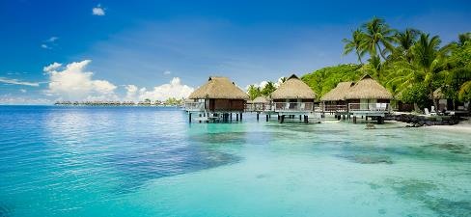
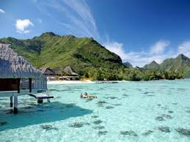
Tahitian coral reefs

Slide 7
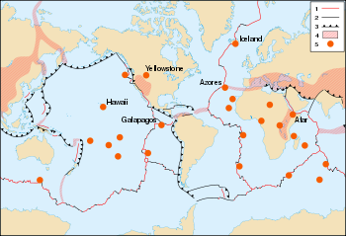
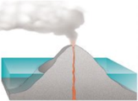
Formation of atolls occur in steps as volcanoes on ocean bottoms rise above sea level

Slide 8
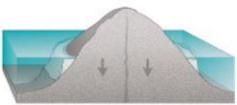
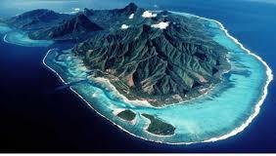
Fringe coral reefs develop around younger exposed volcanoes

Slide 9
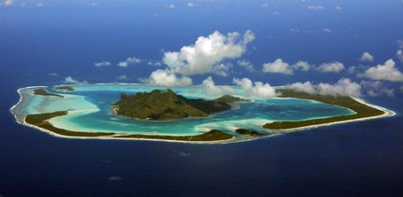

Barrier reefs form as the island begins to both erode and sink due to its weight bearing on the ocean crust.

Slide 10
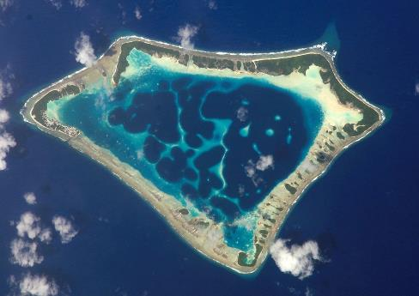

Much older islands finally sink below sea level leaving behind an encircling coral atoll

Slide 11

Most islands are a combination of volcano and atoll that create beautiful lagoons. Reefs with openings to the sea provide safe harbors for ships and smaller boats.

Slide 12
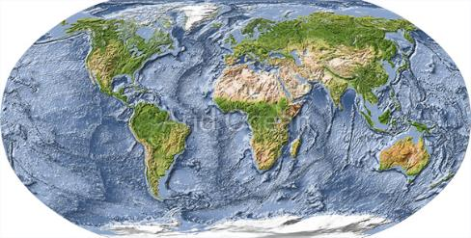
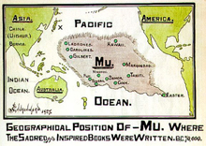
The Land of Mu – More evidence is mounting:
Ancient traditions in the Americas and Indonesia about a lost civilization; sunken megaliths off Japan and near tonga; similar human style statues in Bolivia as are on the islands, the Nazca petroglyphs portray a longing for the mu people to return; and modern underwater topographical mapping

Slide 13
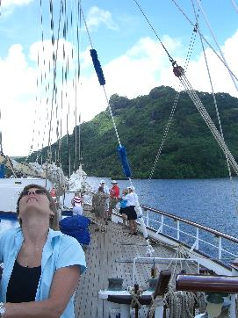
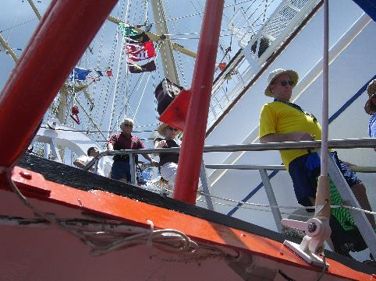
Boarding the starclipper four-masted sailing ship.

Slide 14
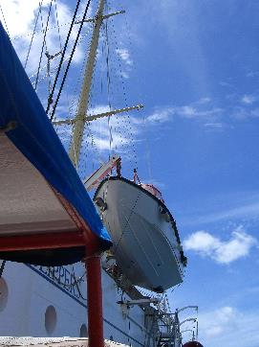
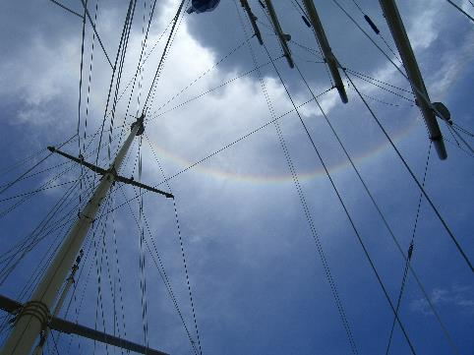
A circular rainbow

Slide 15
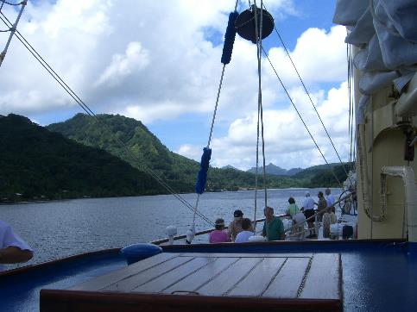
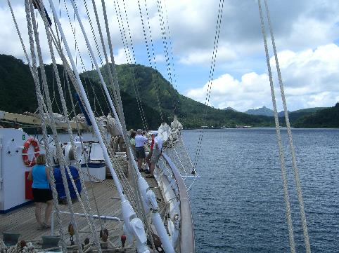
Touring the starclipper decks

Slide 16
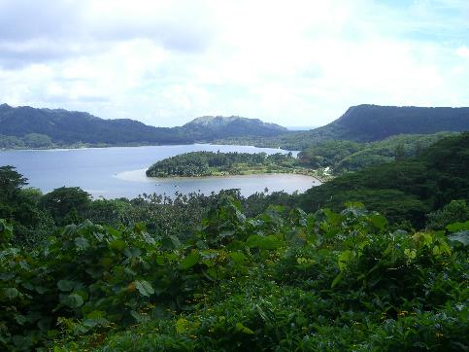
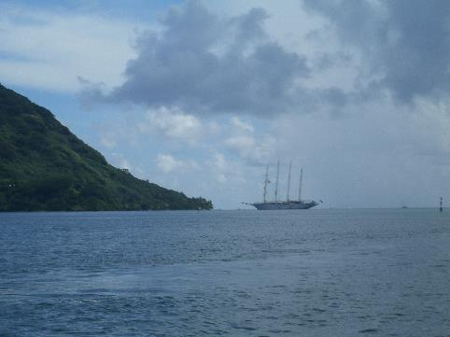
Anchored in a lagoon

Slide 17
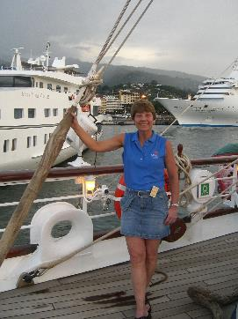
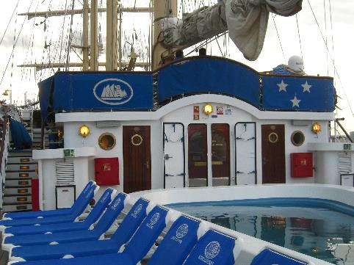
In the harbor at papeete

Slide 18
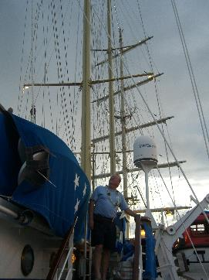
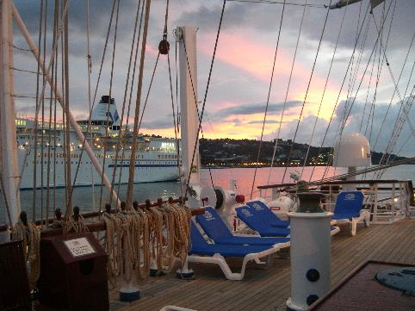
Spars and lines

Slide 19
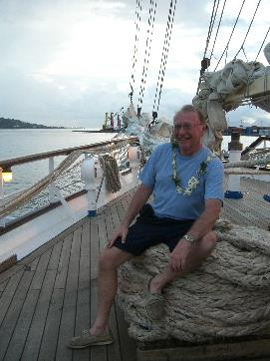
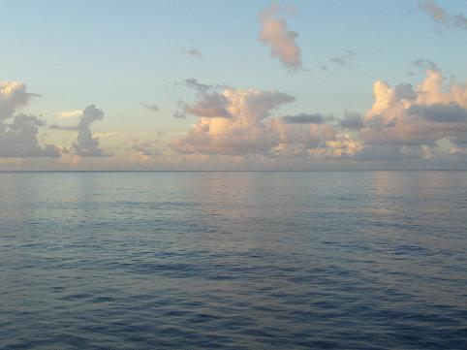
Tropical horizons

Slide 20
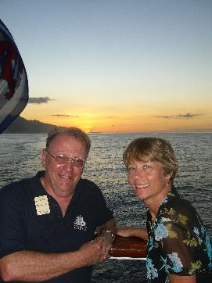
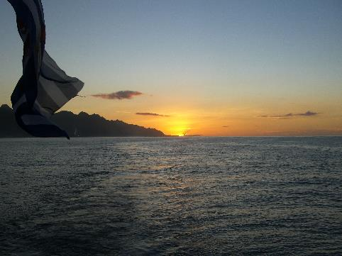
Sunsets off the Stern

Slide 21
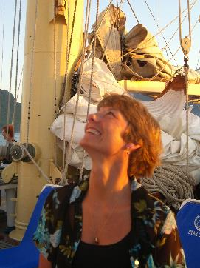
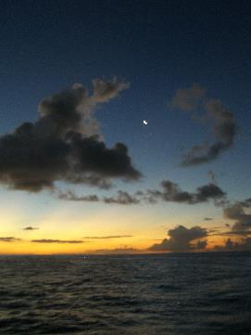
The planets begin showing their reflections as dusk arrives.

Slide 22
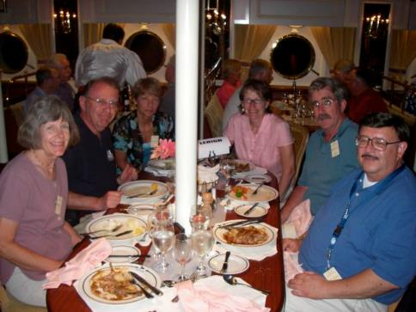
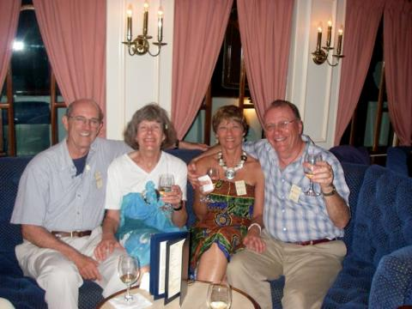
Exquisite dinners onboard with lehigh alumni

Slide 23
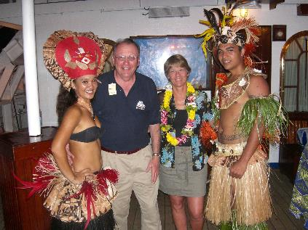
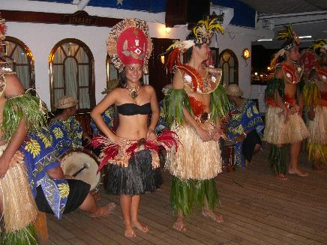
Polynesian dancers come onboard to entertain

Slide 24
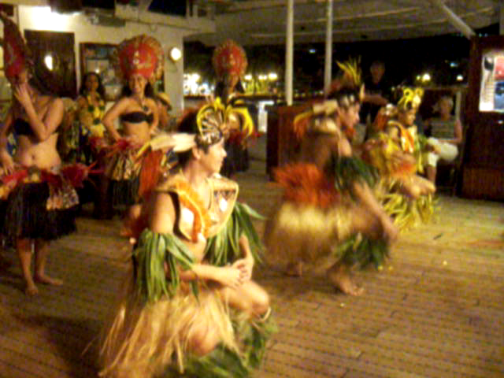

Slide 25
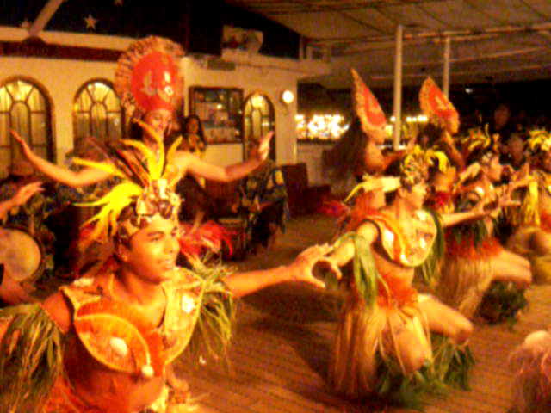

Slide 26
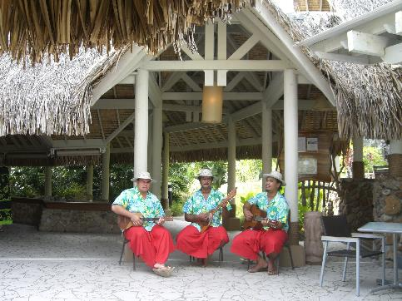
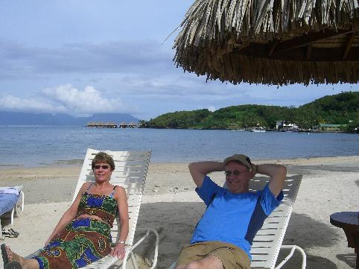
Taking in the sounds and sights

Slide 27
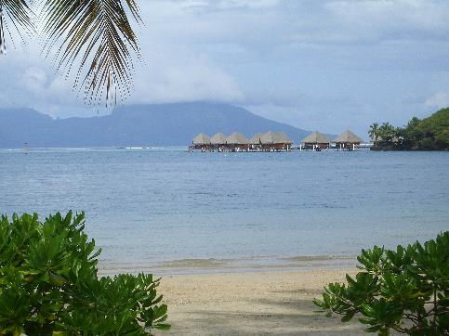
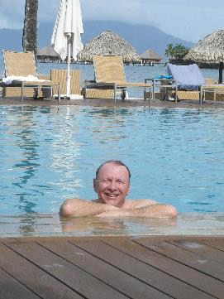
Enjoying the pool and Beach at a island Hotel

Slide 28
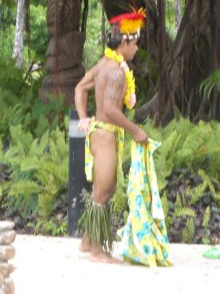
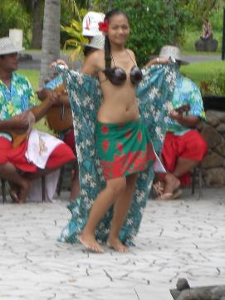
Entertainment in papeete

Slide 29
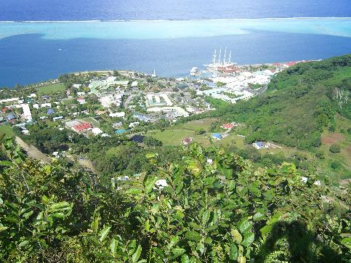
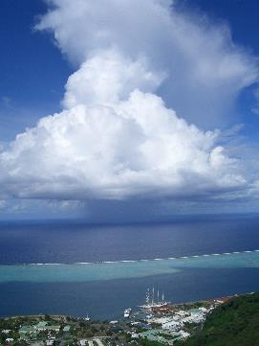
A thunderstorm approaching the harbor

Slide 30
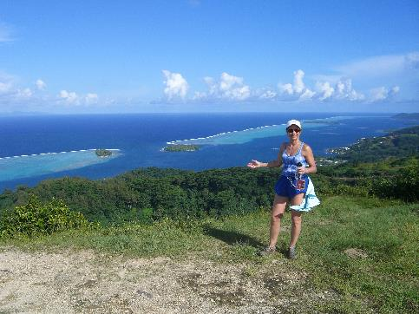

Hiking to a mountain top

Slide 31


Viewing the starclipper from a kayak

Slide 32


Kayaking in the Lagoons

Slide 33


Enjoying a brew from a shoreline kayak Bar

Slide 34


Hoisting the sails

Slide 35


Lounging with the clouds

Slide 36


Shopping on the islands

Slide 37


Daydreaming through a portal

Slide 38


Island tours with open-air buses

Slide 39


Celebrating a joyous time in the society islands

Slide 40


Let’s go sailing

Slide 41


Sailing inside the barrier reef

Slide 42


Snorkeling on the reef

Slide 43


Lonesome fish on the reef

Slide 44


Coconuts, oysters, and pearls

Slide 45


Island river tours

Slide 46


Never lacking wondrous views

Slide 47


Bali hi for Romance

Slide 48


Chicken hide-away

Slide 49


Waterfalls inside the caldera and banyon trees

Slide 50


Lush, succulent colorful flowers of the tropics

Slide 51


The famous Black lava beaches and a waterfall tour

Slide 52


Saying farewells to all our new Friends

Slide 53


It is now time to enjoy one last sunset before saying Good bye to Tahiti

